Slide 1
Softeare and Software Engineering Activity 9: CSS

Slide 2
CSS Fundermentals
HTML

Slide 3

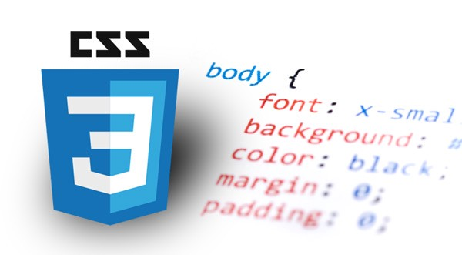
CSS
CSS is stands for Cascading Style Sheets.
It describes how HTML elements are to be displayed on screen, paper or in other media.
It can control the layout of a web page including colors, fonts, links, etc.
Also, CSS is enable to control multiple web pages all at once using external stylesheets.
CSS reduces complexity and repetition in HTML and provides flexibility.
CSS can define a lot of selectors which point to the HTML element and a declaration block for one or more declaration.
CSS has three ways of inserting a style sheet: External CSS, Internal CSS, Inline CSS.

Slide 4
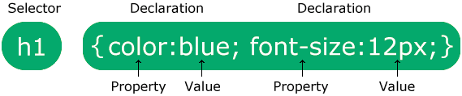

CSS Syntax
The selector points to the HTML element to be styled.
The declaration block contains one or more declarations separated by semicolons.
Each declaration includes a CSS property name and a value, separated by a colon.
Multiple CSS declarations are separated with semicolons, and declaration blocks are surrounded by curly braces.
h1 is a selector in CSS.
color is a property and blue is the property value.
font-size is a property, and 12px is the property value.
<!DOCTYPE html>
<html>
<head>
<style>
h1 { color: blue; text-size: 12px;}
</style>
</head>
<body>
<h1>This is a heading</h1>
</body>
</html>

Slide 5
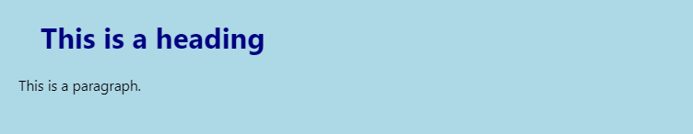
CSS External Style
<!DOCTYPE html>
<html>
<head>
<link rel="stylesheet" href="mystyle.css">
</head>
<body>
<h1>This is a heading</h1>
<p>This is a paragraph.</p>
</body>
</html>
External style can apply to many HTML pages.
External styles are defined within <link> element, inside the <head> section of an HTML page. However, you can specify <link> element outside <head> section.
The external .css file should not contain any HTML tags.
mystyle.css
body {
background-color: lightblue;
}
h1 {
color: navy;
margin-left: 20px;
}

Slide 6
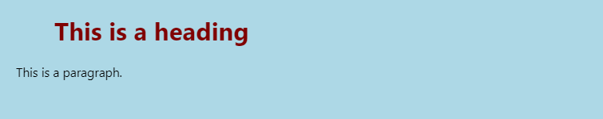
CSS Internal Style
<!DOCTYPE html>
<html>
<head>
<style>
body {
background-color: lightblue;
}
h1 {
color: maroon;
margin-left: 40px;
}
</style>
</head>
<body>
<h1>This is a heading</h1>
<p>This is a paragraph.</p>
</body>
</html>
An internal style element may be used if one single HTML page has a unique style.
The internal style is define inside the <style> element, inside the <head> section.
However, you can specify <style> element outside <head> section.

Slide 7

CSS Inline Style
<!DOCTYPE html>
<html>
<body>
<h1 style="color:blue; text-align:center;">This is a heading</h1>
<p style="color:red;">This is a paragraph.</p>
</body>
</html>
An inline style may be used to apply a unique style for a single element.
To use inline styles, add the style attribute to the relevant element.
The style attribute can contain any CSS property.

Slide 8
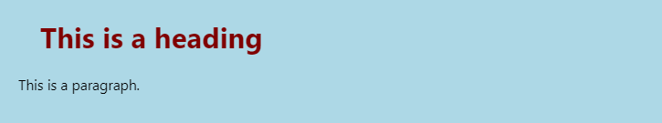
CSS Multiple Styles
<!DOCTYPE html>
<html>
<head>
<link rel="stylesheet" href="mystyle.css">
<style>
h1 { color: maroon;}
</style>
</head>
<body>
<h1>This is a heading</h1>
<p>This is a paragraph.</p>
</body>
</html>
If some properties have been defined for the same selector in different style sheets, the value from the last read style sheet will be used.
So, an inline style has the highest priority, and will override external and internal styles
mystyle.css
body { background-color: lightblue; }
h1 { color: navy; margin-left: 20px; }

Slide 9
CSS Selectors
HTML

Slide 10

CSS Element Selector
<!DOCTYPE html>
<html>
<style>
h1 {
color: blue;
font-size: 24px;
}
p {
color: red;
font-size: 18px;
}
</style>
<body>
<h1>This is a heading</h1>
<p>This is a pragraph</p>
</body>
</html>
The element selector selects HTML element based on the element name such as <h1>, <p>, etc.

Slide 11

CSS id Selector
<!DOCTYPE html>
<html>
<style>
#header {
color: blue;
font-size: 24px;
}
#para {
color: red;
font-size: 18px;
}
</style>
<body>
<h1 id="header">This is a heading selected by header ID</h1>
<p id="para">This is a pragraph seleced by para ID</p>
</body>
</html>
The id selector uses the id attribute of an HTML element to select a specific element.
The id of element is unique within a page, so the id selector is used to select one unique element.
To select an element with a specific id, write a hash (#) character, followed by the id of the element.

Slide 12
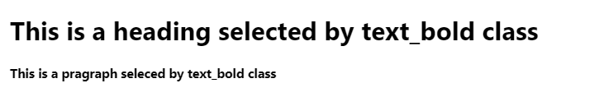
CSS class Selector
<!DOCTYPE html>
<html>
<style>
.text_bold {
font-weight: bold;
}
</style>
<body>
<h1>This is a heading selected by text_bold class</h1>
<p class="text_bold">This is a pragraph seleced by text_bold class</p>
</body>
</html>
The class selector selects HTML elements with a specific class attribute.
The class of an element is not unique within a page, so the class selector is used to select many elements.
To select an element with a specific class, write a period (.) character, followed by the class of the element.

Slide 13

CSS class Selector – Multi classes
<!DOCTYPE html>
<html>
<style>
.text_blue {
color: blue;
}
.text_bold {
font-weight: bold;
}
</style>
<body>
<h1 class="text_bold">This is a </h1>
<p class="text_bold text_blue">This is a pragraph</p>
</body>
</html>
HTML elements can have one or more classes.
In this example, <p> element will be style according to class=“text_bold” and to class=“text_blue”.

Slide 14
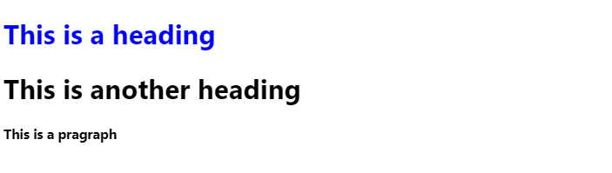
CSS class Selector – Specific Element
<!DOCTYPE html>
<html>
<style>
h1.text_blue {
color: blue;
}
.text_bold {
font-weight: bold;
}
</style>
<body>
<h1 class="text_blue">This is a heading</h1>
<h1>This is another heading</h1>
<p class="text_bold text_blue">This is a pragraph</p>
</body>
</html>
It is possible to specify that only specific HTML elements should be affected by a class.
In this example, only <h1> element with class=“text_blue” will be blue color.

Slide 15
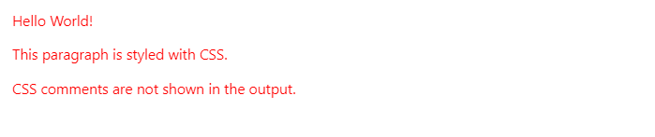
CSS Comment
<!DOCTYPE html>
<html>
<head>
<style>
p {
color: red;
/* Set text color to red */
}
</style>
</head>
<body>
<!-- These paragraphs will be red -->
<p>Hello World!</p>
<p>This paragraph is styled with CSS.</p>
<p>CSS comments are not shown in the output.</p>
</body>
</html>
A CSS comment is placed inside the <style>, and starts with /* and ends with */.

Slide 16
CSS Colors
HTML

Slide 17

CSS Colors by Color Name
<!DOCTYPE html>
<html>
<body>
<h1 style="color:Tomato;"> Tomato</h1>
<h1 style="color:Orange;"> Orange</h1>
<h1 style="color:DodgerBlue;"> DodgerBlue</h1>
<h1 style="color:MediumSeaGreen;"> MediumSeaGreen</h1>
</body>
</html>
A color can be specified by using a predefined color name.
All modern browsers support the 140 color names: https://www.w3schools.com/colors/colors_names.asp

Slide 18
CSS Colors by Hexadecimal Color
<!DOCTYPE html>
<html>
<body>
<h1 style="color:#FF6347;">Tomato</h1>
<h1 style="color:#FFA500;">Orange</h1>
<h1 style="color:#1E90FF;">DodgerBlue</h1>
<h1 style="color:#3CB371;">MediumSeaGreen</h1>
</body>
</html>
A color can be specified by using a hexadecimal color value.
A hexadecimal coloris specified with #RRGGBB.
RR (red), GG (green) and BB (blue) are hexadecimal integers between 00 and FF specifying the intensity of the color.

Slide 19
CSS Colors by RGB Color
<!DOCTYPE html>
<html>
<body>
<h1 style="color:rgb(255, 99, 71);"> Tomato</h1>
<h1 style="color:rgb(255, 165, 0);"> Orange</h1>
<h1 style="color:rgb(30, 144, 255);"> DodgerBlue</h1>
<h1 style="color:rgb(60, 179, 113);"> MediumSeaGreen</h1>
</body>
</html>
An RGB color value is specified with rgb(red, green, blue).
Each parameter (red, green, blue) defines the intensity of the color as an integer between 0 and 255.

Slide 20
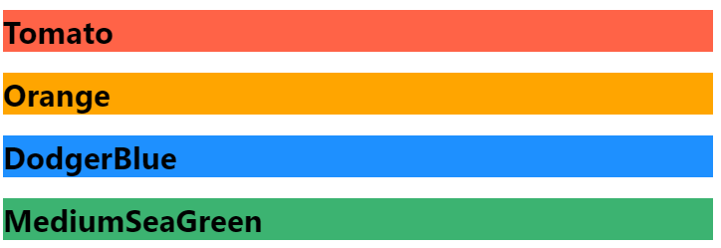
CSS Colors – Background
<!DOCTYPE html>
<html>
<body>
<h1 style="background:Tomato;">Tomato</h1>
<h1 style="background:Orange;">Orange</h1>
<h1 style="background:DodgerBlue;">DodgerBlue</h1>
<h1 style="background:MediumSeaGreen;">MediumSeaGreen</h1>
</body>
</html>
You can set the background color for HTML elements using background or background-color property.

Slide 21
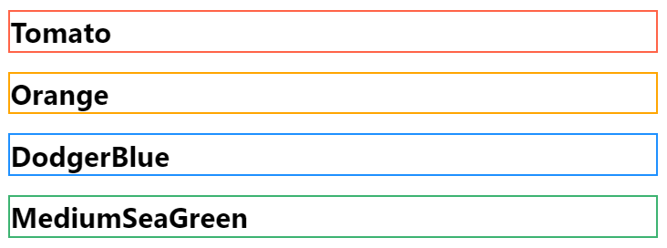
CSS Colors – Border Color
<!DOCTYPE html>
<html>
<body>
<h1 style="border:2px solid Tomato;"> Tomato</h1>
<h1 style="border:2px solid Orange;"> Orange</h1>
<h1 style="border:2px solid DodgerBlue;"> DodgerBlue</h1>
<h1 style="border:2px solid MediumSeaGreen;"> MediumSeaGreen</h1>
</body>
</html>
You can set the color of borders for HTML elements using border property with mixed values.
There is border-color property, however, the border-color does not work if it is used alone.

Slide 22
CSS Margins and Paddings
HTML

Slide 23
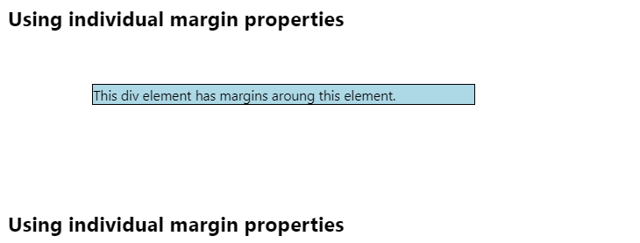
CSS Margins
<!DOCTYPE html>
<html>
<head>
<style>
div {
border: 1px solid black;
margin: 50px 150px 100px 80px;
background-color: lightblue;
}
</style>
</head>
<body>
<h2>Using individual margin properties</h2>
<div>This div element has margins aroung this element. </div>
<h2>Using individual margin properties</h2>
</body>
</html>
The CSS margin properties are used to create space around elements, outside of any defined borders.
There are properties for setting the margin for each side of an element (top, right, bottom, left).

Slide 24
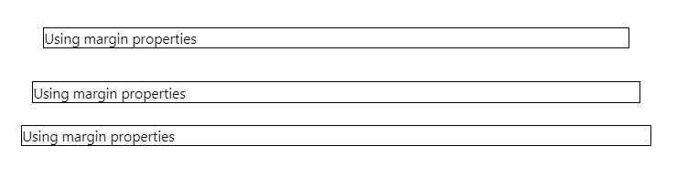
CSS Margins
<!DOCTYPE html>
<html>
<head>
<style>
.three_margin {
border: 1px solid black;
margin: 10px 10px 10px;
}
.two_margin {
border: 1px solid black;
margin: 20px 20px;
}
.one_margin {
border: 1px solid black;
margin: 30px;
}
</style>
</head>
<body>
<p class="one_margin">Using margin properties</p>
<p class="two_margin">Using margin properties</p>
<p class="three_margin">Using margin properties</p>
</body>
</html>
If the margin property has one value, all four margin are the value.
If the margin property has two values, the top and bottom margins are the first value and the right and left margins are the second value.
If the margin property has three values, the first is for the top, the second is for the right and left, and the last is for bottom.

Slide 25
CSS Margins – Individuals
<!DOCTYPE html>
<html>
<head>
<style>
div {
border: 1px solid black;
margin-top: 50px;
margin-bottom: 100px;
margin-right: 150px;
margin-left: 80px;
background-color: lightblue;
}
</style>
</head>
<body>
<h2>Using individual margin properties</h2>
<div>This div element has margins aroung this element. </div>
<h2>Using individual margin properties</h2>
</body>
</html>
The CSS has properties for specifying the margin for each side of an element: margin-top, margin-right, margin-bottom, margin-left.
All the margin properties can have the following values: auto (calculates the margin), length (cm, px, etc), percentage (% of the width of the containing element), inherit (inherited from the parent element).

Slide 26
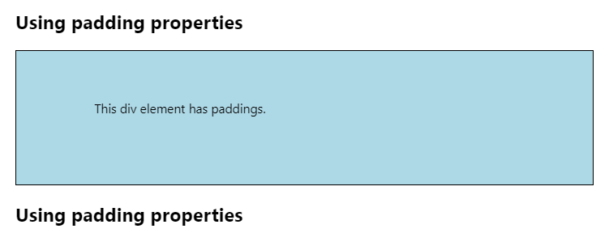
CSS Paddings
<!DOCTYPE html>
<html>
<head>
<style>
div {
border: 1px solid black;
padding: 50px 60px 70px 80px;
background-color: lightblue;
}
</style>
</head>
<body>
<h2>Using padding properties</h2>
<div>This div element has paddings.</div>
<h2>Using padding properties</h2>
</body>
</html>
The CSS padding properties are used to generate space around the an element’s content, inside of any defined borders.
There are properties for setting the padding for each side of an element (top, right, bottom, left).

Slide 27
CSS Paddings
<!DOCTYPE html>
<html>
<head>
<style>
div {
border: 1px solid black;
padding-top: 50px;
padding-right: 60px;
padding-bottom: 70px;
padding-left: 80px;
background-color: lightblue;
}
</style>
</head>
<body>
<h2>Using padding properties</h2>
<div>This div element has paddings.</div>
<h2>Using padding properties</h2>
</body>
</html>
The CSS has properties for specifying the padding for each side of an element: padding-top, padding-right, padding-bottom, padding-left.
All the padding properties can have the following values: auto (calculates the margin), length (cm, px, etc), percentage (% of the width of the containing element), inherit (inherited from the parent element).

Slide 28
CSS Height and Width
HTML

Slide 29
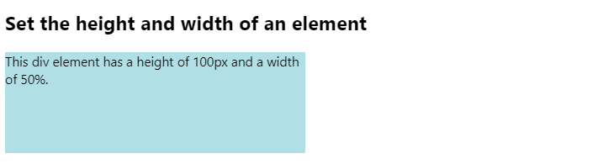
CSS Height and Width
<!DOCTYPE html>
<html>
<head>
<style>
div {
height: 100px;
width: 50%;
background-color: powderblue;
}
</style>
</head>
<body>
<h2>Set the height and width of an element</h2>
<div>This div element has a height of 100px and a width of 50%.</div>
</body>
</html>
The CSS height and width properties are used to set the height and width of an element.
The height and width properties do not include padding, borders, or margins.
The height and width properties may have following values: auto (calculates the margin by browser), length (cm, px, etc), percentage (% of the width of the containing element), inherit (inherited from the parent element).

Slide 30
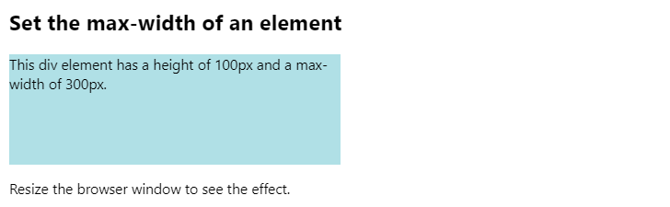
CSS Max Height
<!DOCTYPE html>
<html>
<head>
<style>
div {
max-width: 300px;
height: 100px;
background-color: powderblue;
}
</style>
</head>
<body>
<h2>Set the max-width of an element</h2>
<div>This div element has a height of 100px and a max-width of 300px.</div>
<p>Resize the browser window to see the effect.</p>
</body>
</html>
The max-width property is used to set the maximum width of an element.
The max-width can be specified in length values, like px, cm, etc, or in percent (%) of the containing block, or set to none (this is default).
If the browser windows is smaller than the width of the element, the browser adds a horizontal scrollbar to the page.

Slide 31
CSS Position
HTML

Slide 32
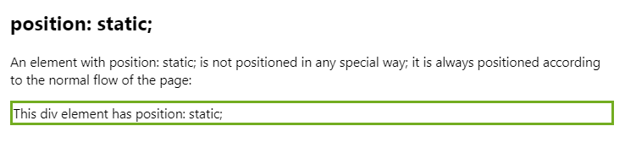
CSS Position – Static
<!DOCTYPE html>
<html>
<head>
<style>
div.static {
position: static;
border: 3px solid #73AD21;
}
</style>
</head>
<body>
<h2>position: static;</h2>
<p>An element with position: static; is not positioned in any special way; it is always positioned according to the normal flow of the page:</p>
<div class="static">
This div element has position: static;
</div>
</body>
</html>
The position property specifies the type of positioning method used for an element.
There are five different position values: static, relative, fixed, absolute, sticky.
static is a default value for HTML.
An element with position: static; is not positioned in any special way.
It is always positioned according to the normal flow of the page.

Slide 33
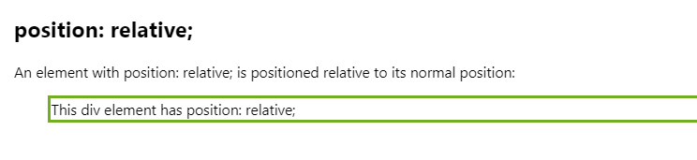
CSS Position – Relative
<!DOCTYPE html>
<html>
<head>
<style>
div.relative {
position: relative;
left: 30px;
border: 3px solid #73AD21;
}
</style>
</head>
<body>
<h2>position: relative;</h2>
<p>An element with position: relative; is positioned relative to its normal position:</p>
<div class="relative">
This div element has position: relative;
</div>
</body>
</html>
An element with position: relative; is positioned relative to its normal position.
Setting the top, right, bottom, and left properties of a relatively positioned element will cause it to be adjusted away from its normal position.
Other content will not be adjusted to fit into any gap left by the element.

Slide 34
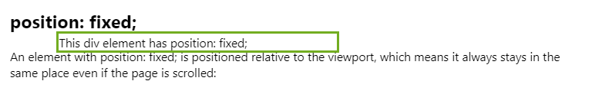
CSS Position – Fixed
<!DOCTYPE html>
<html>
<head>
<style>
div.fixed {
position: fixed;
top: 40px;
left: 70px;
width: 300px;
border: 3px solid #73AD21;
}
</style>
</head>
<body>
<h2>position: fixed;</h2>
<p>An element with position: fixed; is positioned relative to the viewport, which means it always stays in the same place even if the page is scrolled:</p>
<div class="fixed">
This div element has position: fixed;
</div>
</body>
</html>
An element with position: fixed; is positioned relative to the viewport, which means it always stays in the same place even if the page is scrolled.
A fixed element does not leave a gap in the page where it would normally have been located.

Slide 35
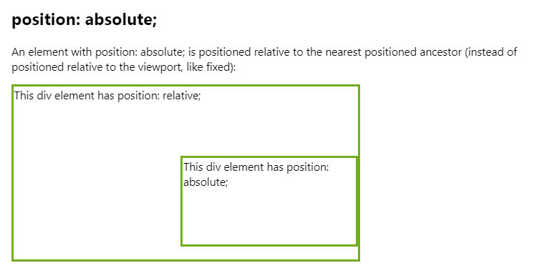
CSS Position – Absolute
<!DOCTYPE html>
<html>
<head>
<style>
div.relative {
position: relative;
width: 400px;
height: 200px;
border: 3px solid #73AD21;
}
div.absolute {
position: absolute;
top: 80px;
right: 0;
width: 200px;
height: 100px;
border: 3px solid #73AD21;
}
</style>
</head>
<body>
<h2>position: absolute;</h2>
<p>An element with position: absolute; is positioned relative to the nearest positioned ancestor (instead of positioned relative to the viewport, like fixed):</p>
<div class="relative">This div element has position: relative;
<div class="absolute">This div element has position: absolute;</div>
</div>
</body>
</html>
An element with position: absolute; is positioned relative to the nearest positioned ancestor.
Absolute positioned elements are removed from the normal flow, and can overlap elements.

Slide 36
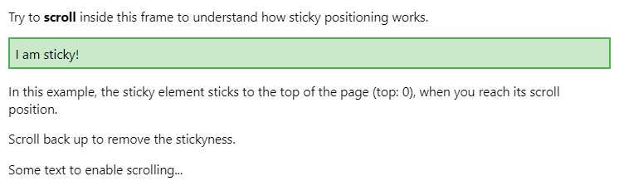
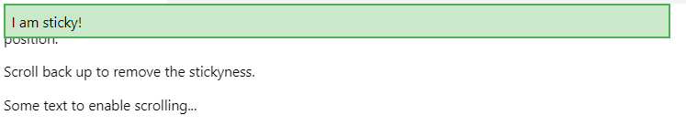
CSS Position – Sticky
<!DOCTYPE html>
<html>
<head>
<style>
div.sticky {
position: -webkit-sticky;
position: sticky;
top: 0;
padding: 5px;
background-color: #cae8ca;
border: 2px solid #4CAF50;
}
</style>
</head>
<body>
<p>Try to <b>scroll</b> inside this frame to understand how sticky positioning works.</p>
<div class="sticky">I am sticky!</div>
<div style="padding-bottom:2000px">
<p>In this example, the sticky element sticks to the top of the page (top: 0), when you reach its scroll position.</p>
<p>Scroll back up to remove the stickyness.</p>
<p>Some text to enable scrolling...</p>
</div>
</body>
</html>
An element with position: sticky; is positioned based on the user’s scroll position.
A sticky element toggles between relative and fixed, depending on the scroll position.
It is positioned relative until a given offset position is met in the viewport.

Slide 37
CSS images
HTML

Slide 38
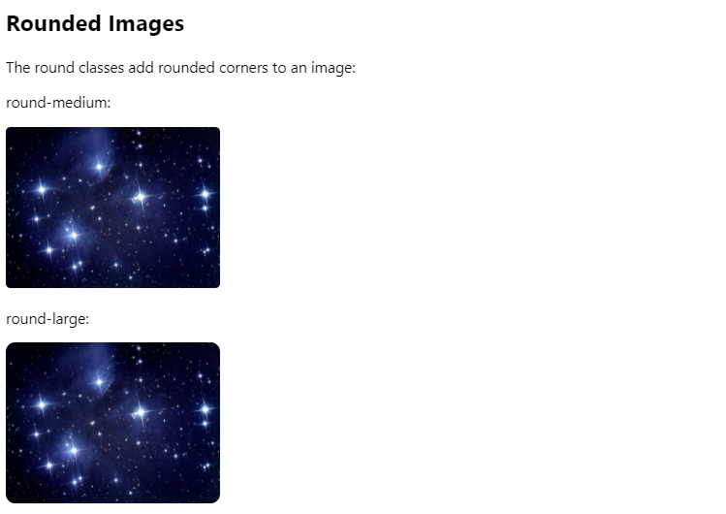
CSS Images – Round
<!DOCTYPE html>
<html>
<head>
<style>
.round-medium {
border-radius: 4px
}
.round-large {
border-radius: 8px
}
</style>
</head>
<body>
<h2>Rounded Images</h2>
<p>The round classes add rounded corners to an image:</p>
<p>round-medium:</p>
<img src="star.jpg" class="round-medium" style="width:30%">
<p>round-large:</p>
<img src="star.jpg" class="round-large" style="width:30%">
</body>
</html>
The round-medium and round-large class add rounded corners to an image.

Slide 39
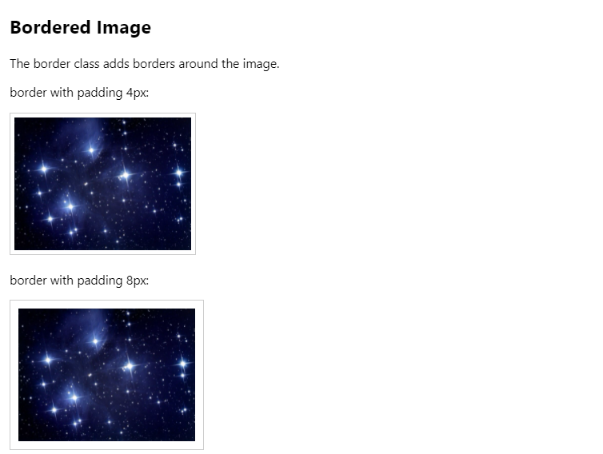
CSS Images – Border
<!DOCTYPE html>
<html>
<head>
<style>
.border {
border: 1px solid #ccc
}
</style>
</head>
<body>
<h2>Bordered Image</h2>
<p>The border class adds borders around the image.</p>
<p>border with padding 4px:</p>
<img src="star.jpg" class="border" style="padding:4px; width:30%">
<p>border with padding 8px:</p>
<img src="star.jpg" class="border" style="padding:8px; width:30%">
</body>
</html>
The border class add borders around the image.

Slide 40
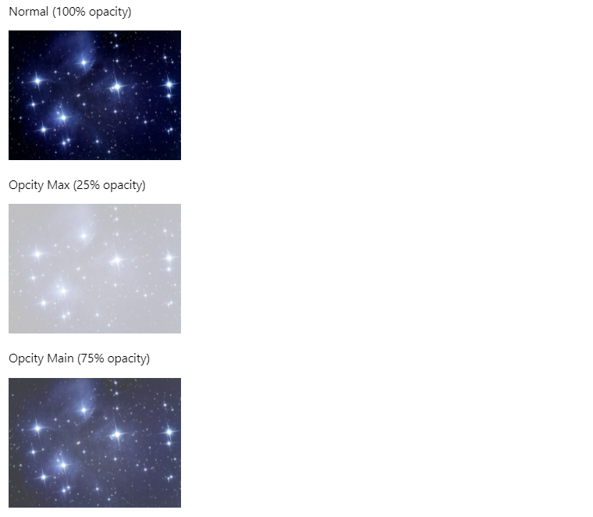
CSS Images – Opacity
<!DOCTYPE html>
<html>
<head>
<style>
.opacity { opacity: 1 }
.opacity-max { opacity: 0.25 }
.opacity-min { opacity: 0.75 }
</style>
</head>
<body>
<p>Normal (100% opacity)</p>
<img src="star.jpg" class="opacity" style="width:30%">
<p>Opcity Max (25% opacity)</p>
<img src="star.jpg" class="opacity-max" style="width:30%">
<p>Opcity Main (75% opacity)</p>
<img src="star.jpg" class="opacity-min" style="width:30%">
</body>
</html>
The opacity class makes images transparent.

Slide 41
CSS Layout
HTML

Slide 42
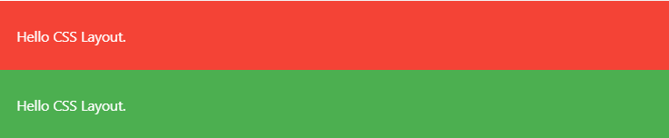
CSS Layout – Vertical Block
<!DOCTYPE html>
<html>
<head>
<style>
.container {
display: block;
padding: 10px 16px;
}
.red {
color: #fff;
background-color: #f44336
}
.green {
color: #fff;
background-color: #4CAF50
}
</style>
</head>
<body>
<div class="container red"><p>Hello CSS Layout.</p></div>
<div class="container green"><p>Hello CSS Layout.</p></div>
</body>
</html>
The display property with “block” value displays an element vertically.

Slide 43

CSS Layout – Horizontal Block
<!DOCTYPE html>
<html>
<head>
<style>
.container {display: block; padding: 10px 16px; }
.cell { display: table-cell; }
.red { color: #fff; background-color: #f44336 }
.green { color: #fff; background-color: #4CAF50 }
</style>
</head>
<body>
<div class="container red cell">
<p>Hello CSS Layout.</p>
</div>
<div class="container green cell">
<p>Hello CSS Layout.</p>
</div>
</body>
</html>
The display property with “table-cell” value redefines block elements to display horizontally.

Slide 44

CSS Layout – Full Horizontal Block
<!DOCTYPE html>
<html>
<head>
<style>
.container {display: block; padding: 10px 16px; }
.row { display: table; width: 100% }
.cell { display: table-cell; }
.red { color: #fff; background-color: #f44336 }
.green { color: #fff; background-color: #4CAF50 }
</style>
</head>
<body>
<div class="row">
<div class="container red cell">
<p>Hello CSS Layout.</p>
</div>
<div class="container green cell">
<p>Hello CSS Layout.</p>
</div>
</div>
</body>
</html>
The row class defines the total width of all the contained cells.

Slide 45
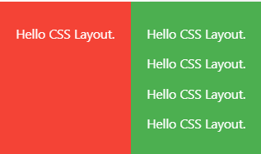
CSS Layout – Self Adjust Block
<!DOCTYPE html>
<html>
<head>
<style>
.container {display: block; padding: 10px 16px; }
.cell { display: table-cell; }
.red { color: #fff; background-color: #f44336 }
.green { color: #fff; background-color: #4CAF50 }
</style>
</head>
<body>
<div class="container red cell">
<p>Hello CSS Layout.</p>
</div>
<div class="container green cell">
<p>Hello CSS Layout.</p>
<p>Hello CSS Layout.</p>
<p>Hello CSS Layout.</p>
<p>Hello CSS Layout.</p>
</div>
</body>
</html>
Side-by-side cell class with “display:table-cell;” will also automatically self-adjust to equal height.

Slide 46
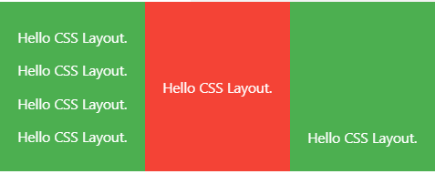
CSS Layout – Text Alignment Block
<!DOCTYPE html>
<html>
<head>
<style>
.container {display: block; padding: 10px 16px; }
.cell { display: table-cell; }
.cell-middle { vertical-align: middle }
.cell-bottom { vertical-align: bottom }
.red { color: #fff; background-color: #f44336 }
.green { color: #fff; background-color: #4CAF50 }
</style>
</head>
<body>
<div class="container green cell">
<p>Hello CSS Layout.</p>
<p>Hello CSS Layout.</p>
<p>Hello CSS Layout.</p>
<p>Hello CSS Layout.</p>
</div>
<div class="container red cell cell-middle">
<p>Hello CSS Layout.</p>
</div>
<div class="container green cell cell-bottom">
<p>Hello CSS Layout.</p>
</div>
</body>
</html>
Using vertical-align property with the values, “top”, “middle”, “bottom” for vertical-align, it is easy to align text.

Slide 47
CSS Inputs
HTML

Slide 48
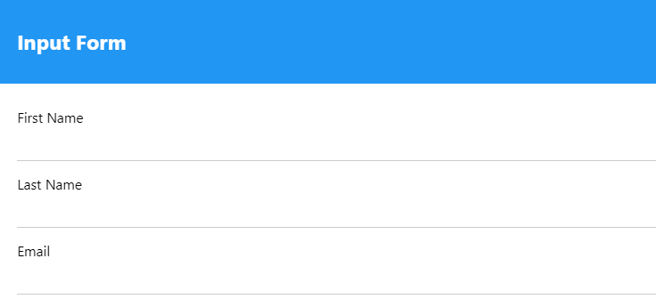
CSS Inputs – Form
<!DOCTYPE html>
<html>
<head>
<style>
.container { display: block; padding: 10px 16px; }
.blue { color: #fff; background-color: #2196F3; }
.input { padding: 8px; display: block; border: none; border-bottom: 1px solid #ccc; width: 100% }
</style>
</head>
<body>
<div class="container blue">
<h2>Input Form</h2>
</div>
<form class=container ">
<p>
<label>First Name</label>
<input class="input " type="text ">
</p>
<p>
<label>Last Name</label>
<input class="input " type="text ">
</p>
<p>
<label>Email</label>
<input class="input " type="text ">
</p>
</form>
</body>
</html>
The input class displays the input element nicely using padding, display, border and width property.

Slide 49
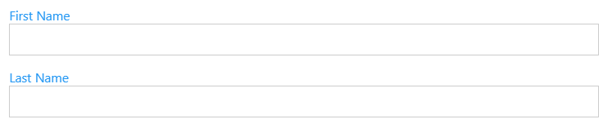
CSS Inputs – Color Label
<!DOCTYPE html>
<html>
<head>
<style>
.container { display: block; padding: 10px 16px; }
.text_blue { color: #2196F3; }
.blue { color: #fff; background-color: #2196F3; }
.input { padding: 8px; display: block; border: none; border-bottom: 1px solid #ccc; width: 100% }
</style>
</head>
<body>
<form class=container ">
<p>
<label class="text_blue ">First Name</label>
<input class="input border " type="text ">
</p>
<p>
<label class="text_blue ">Last Name</label>
<input class="input border " type="text ">
</p>
</form>
</body>
</html>
You can change the label color using text_blue class.

Slide 50
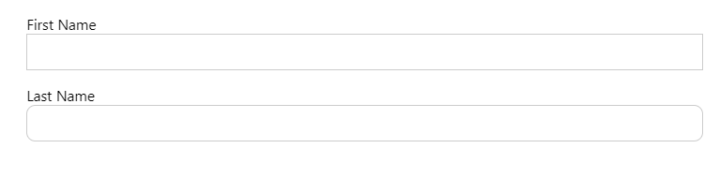
CSS Inputs – Round Input
<!DOCTYPE html>
<html>
<head>
<style>
.container { display: block; padding: 10px 16px; }
.input {
padding: 8px;
display: block;
border: none;
border-bottom: 1px solid #ccc;
width: 100%
}
.border { border: 1px solid #ccc }
.round-medium { border-radius: 4px }
.round-large { border-radius: 8px }
</style>
</head>
<body>
<form class=container ">
<p>
<label>First Name</label>
<input class="input border " type="text ">
</p>
<p>
<label>Last Name</label>
<input class="input border round-large " type="text ">
</p>
</form>
</body>
</html>
To make a round input, use round-large class which has border-radius property.

Slide 51
CSS Fonts
HTML

Slide 52
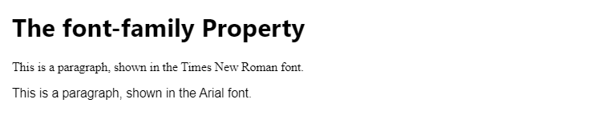
CSS Fonts – Font Family
<!DOCTYPE html>
<html>
<style>
p.a {
font-family: "Times New Roman", Times, serif;
}
p.b {
font-family: Arial, Helvetica, sans-serif;
}
</style>
<body>
<h1>The font-family Property</h1>
<p class="a">This is a paragraph, shown in the Times New Roman font.</p>
<p class="b">This is a paragraph, shown in the Arial font.</p>
</body>
</html>
The font-family property specifies the font for an element.
The font-family property can hold several font names. If the browser does not support the first font, it tries the next font.
There are two types of font family names:
Family-name: the name of a font-family like “times’, “courier”, “arial”, etc.
Generic-family: the name of a generic-family like “serif”, “sans-serif”, “cursive”, etc.

Slide 53
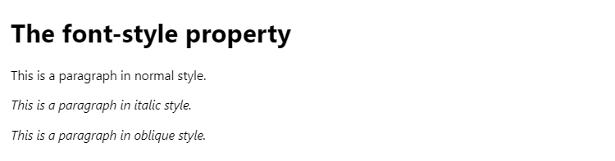
CSS Fonts – Font Style
<!DOCTYPE html>
<html>
<head>
<style>
p.normal {
font-style: normal;
}
p.italic {
font-style: italic;
}
p.oblique {
font-style: oblique;
}
</style>
</head>
<body>
<h1>The font-style property</h1>
<p class="normal">This is a paragraph in normal style.</p>
<p class="italic">This is a paragraph in italic style.</p>
<p class="oblique">This is a paragraph in oblique style.</p>
</body>
</html>
The font-style property is mostly used to italic text.
This property has three values:
normal: The text is shown normally.
italic: The text is shown in italics.
oblique: the text is leaning but less supported.

Slide 54
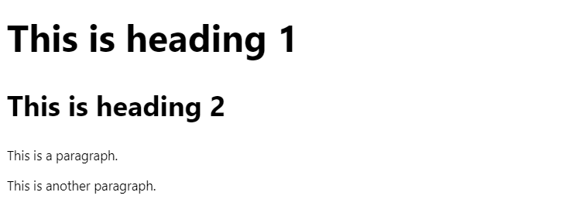
CSS Fonts – Font Size
<!DOCTYPE html>
<html>
<head>
<style>
h1 {
font-size: 40px;
}
h2 {
font-size: 30px;
}
p {
font-size: 14px;
}
</style>
</head>
<body>
<h1>This is heading 1</h1>
<h2>This is heading 2</h2>
<p>This is a paragraph.</p>
<p>This is another paragraph.</p>
</body>
</html>
The font-size property sets the size of the text.
Always use the proper HTML tags like <h1> - <h6> for headings and <p> for paragraphs.
The font-size value can be an absolute, or relative size.

Slide 55
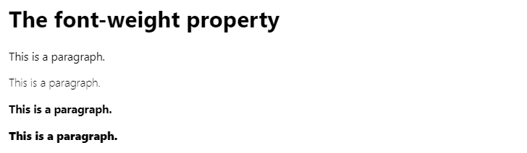
CSS Fonts – Font Weight
<!DOCTYPE html>
<html>
<head>
<style>
p.normal {
font-weight: normal;
}
p.light {
font-weight: lighter;
}
p.thick {
font-weight: bold;
}
p.thicker {
font-weight: 900;
}
</style>
</head>
<body>
<h1>The font-weight property</h1>
<p class="normal">This is a paragraph.</p>
<p class="light">This is a paragraph.</p>
<p class="thick">This is a paragraph.</p>
<p class="thicker">This is a paragraph.</p>
</body>
</html>
The font-weight property specifies the weight of a font.
The values for font-weight property are normal, bold, lighter, bolder, and a <number> value between 1 and 1000.

Slide 56
CSS Links
HTML

Slide 57

CSS Links – Link Color
<!DOCTYPE html>
<html>
<head>
<style>
a {
color: hotpink;
}
</style>
</head>
<body>
<h2>Style a link with a color</h2>
<p><b><a href="https://warwick.ac.uk/" target="_blank">This is a link</a></b></p>
</body>
</html>
Links can be styled with any CSS property (e.g. color, font-family, background, etc)

Slide 58
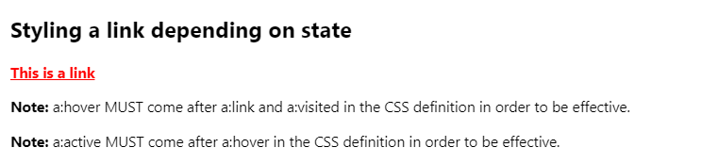
CSS Links – Link State
<!DOCTYPE html>
<html>
<head>
<style>
a:link { /* unvisited link */
color: red;
}
a:visited { /* visited link */
color: green;
}
a:hover { /* mouse over link */
color: hotpink;
}
a:active { /* selected link */
color: blue;
}
</style>
</head>
<body>
<h2>Styling a link depending on state</h2>
<p><b><a href="https://warwick.ac.uk/" target="_blank">This is a link</a></b></p>
<p><b>Note:</b> a:hover MUST come after a:link and a:visited in the CSS definition in order to be effective.</p>
<p><b>Note:</b> a:active MUST come after a:hover in the CSS definition in order to be effective.</p>
</body>
</html>
Links can be styled differently depending on what state they are in.
The four links states are:
a:link – a normal, unvisited link
a:visited – a link the user has visited
a:hover – a link when the user mouses over it
a:active – a link the moment it is clicked.

Slide 59

CSS Links – Remove Underlines from Links
<!DOCTYPE html>
<html>
<head>
<style>
a:link {
text-decoration: none;
}
</style>
</head>
<body>
<h2>Styling a link with text-decoration property</h2>
<p><b><a href="https://warwick.ac.uk/" target="_blank">This is a link</a></b></p>
</body>
</html>
The text-decoration property is mostly used to remove underlines from links.

Slide 60
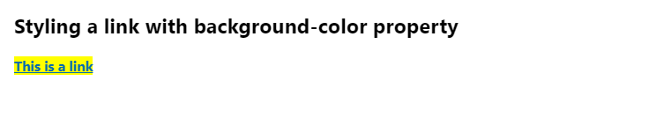
CSS Links – Background
<!DOCTYPE html>
<html>
<head>
<style>
a:link {
background-color: yellow;
}
</style>
</head>
<body>
<h2>Styling a link with background-color property</h2>
<p><b><a href="https://warwick.ac.uk/" target="_blank">This is a link</a></b></p>
</body>
</html>
The background-color property can be used to specify a background color for links.

Slide 61
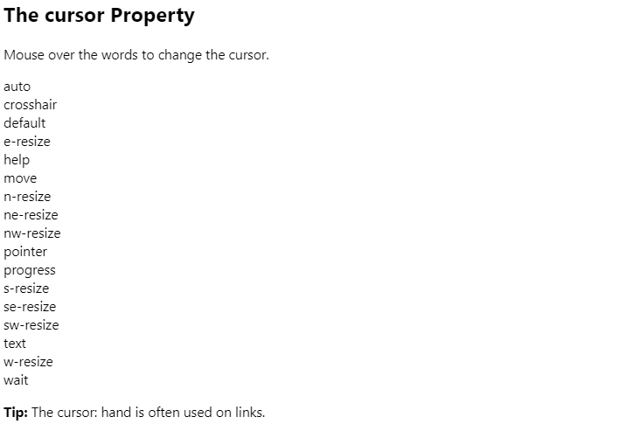
CSS Links – Cursor
<!DOCTYPE html>
<html>
<body>
<h2>The cursor Property</h2>
<p>Mouse over the words to change the cursor.</p>
<span style="cursor:auto">auto</span><br>
<span style="cursor:crosshair">crosshair</span><br>
<span style="cursor:default">default</span><br>
<span style="cursor:e-resize">e-resize</span><br>
<span style="cursor:help">help</span><br>
<span style="cursor:move">move</span><br>
<span style="cursor:n-resize">n-resize</span><br>
<span style="cursor:ne-resize">ne-resize</span><br>
<span style="cursor:nw-resize">nw-resize</span><br>
<span style="cursor:pointer">pointer</span><br>
<span style="cursor:progress">progress</span><br>
<span style="cursor:s-resize">s-resize</span><br>
<span style="cursor:se-resize">se-resize</span><br>
<span style="cursor:sw-resize">sw-resize</span><br>
<span style="cursor:text">text</span><br>
<span style="cursor:w-resize">w-resize</span><br>
<span style="cursor:wait">wait</span><br>
<p><strong>Tip:</strong> The cursor: hand is often used on links.</p>
</body>
</html>
Using cursor property, links can have different types of cursor.

Slide 62

MAIN REFERENCE
GeeksforGeeks: https://www.geeksforgeeks.org/css-tutorials/
MDB Web Docs:
https://developer.mozilla.org/en-US/docs/Learn/Getting_started_with_the_web/CSS_basics
TutorialRepublic: https://www.tutorialrepublic.com/css-tutorial/
web.dev.com https://web.dev/learn/css/
javaTpoint: https://www.javatpoint.com/css-tutorial
W3.CSS
https://www.w3schools.com/w3css/defaulT.asp

Slide 63
THANKS!
Q & A
Any questions?
y.s.park@warwick.ac.uk

